Slide 1
EAGNA
An Integrated Virtual Learning Environment
Conor Davis | C20441826 | TU856/4
Supervisor – Eoin Rogers

Slide 2

Overview
Eagna is a condensed Virtual Learning Environment designed for the Technological University of Dublin.
Features:
Login for Student & Lecturers.
Registration for Students.
Modules & Assignments.
Admin & External Tools.

Slide 3
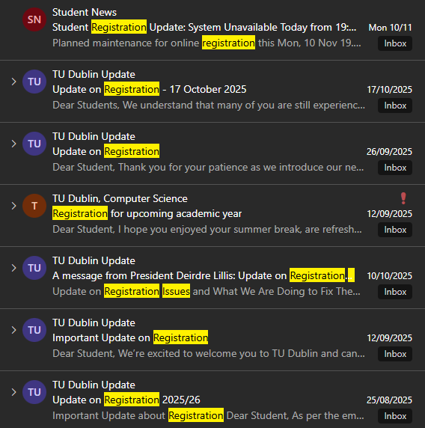
Why?
This project was designed to deal with the registration & Brightspace enrolment problem.
Advantages:
Built to be hosted on-site or on-cloud.
Change features on-demand.
Control over security & management of sensitive data.

Slide 4
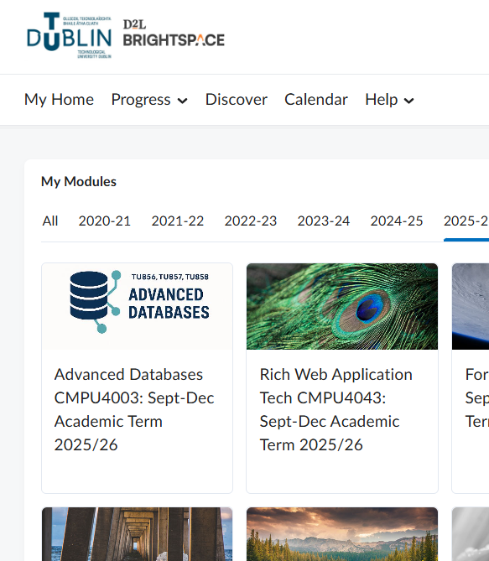
Research
Extensive research was performed to understand VLEs.
Including:
Existing VLEs (Brightspace etc.)
Technologies (Django etc.)
Requirements (Accessibility etc.)
Existing Final Year Projects

Slide 5
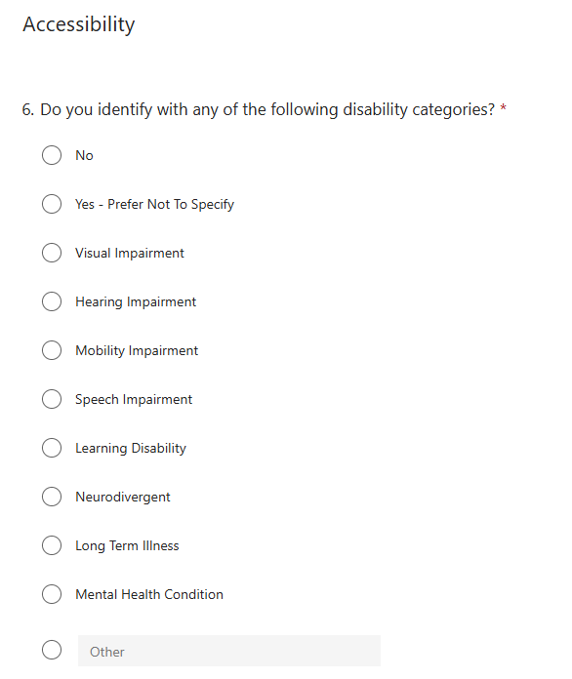
Requirements
Feedback collection & requirements gathering performed to understand user needs.
Including:
Questionnaires
Brightspace Feature Review
Use Case Scenarios
Requirements Specification

Slide 6
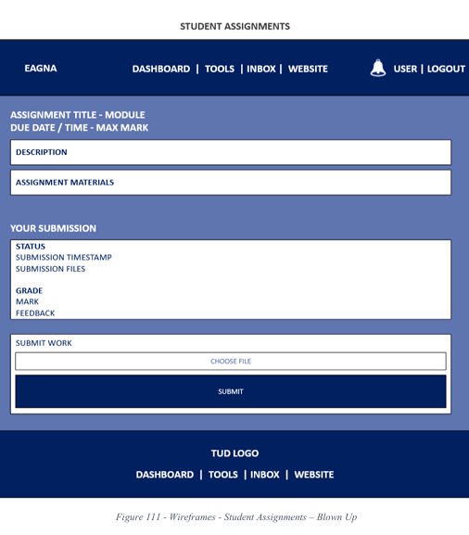
Design
Feature Driven Development was chosen as the methodology.
The design of Eagna has been outlined based on the following:
Dependencies
Complexity
Risk
Wireframes & Diagrams have been used to visualize the design.

Slide 7
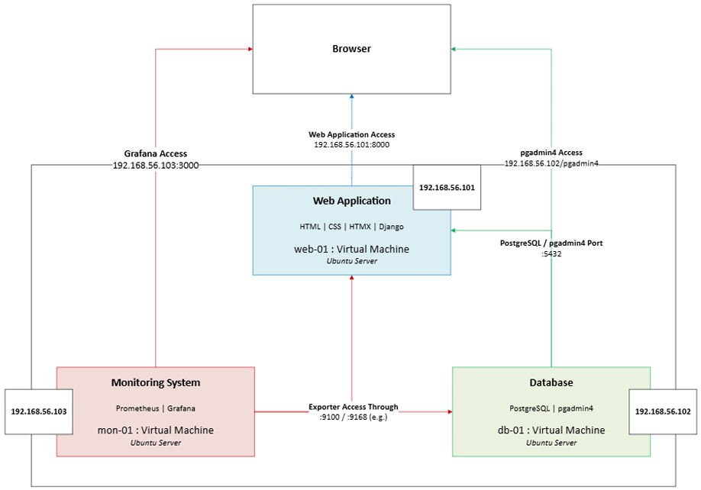
SYSTEM OVERVIEW

Slide 8








Implementation
These technologies were chosen to build the system:
Frontend: HTML, CSS, HTMX (JS)
Backend: Django
Database: PostgreSQL
Virtualization: VirtualBox (Ubuntu Server 24.04 LTS)
Monitoring: Prometheus & Grafana

Slide 9
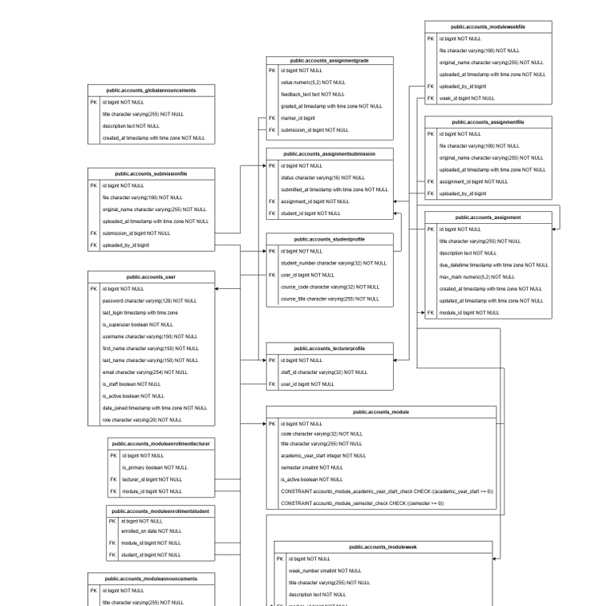
Complexity
With three interconnected virtual machines running a variety of technologies – the complexity in this project is significant.
Rich Role-Based Domain Logic & Access Control
Distributed & Database Backed Architecture
Concurrent User Support
Dynamic User Interface

Slide 10
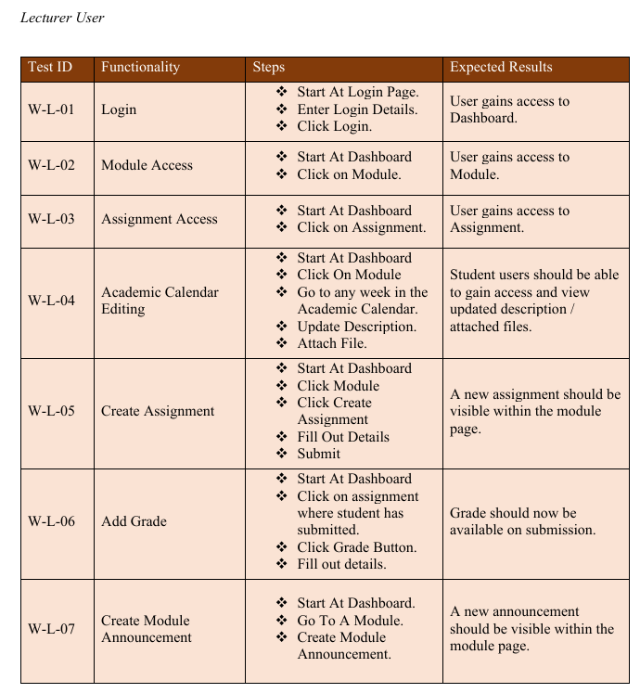
Testing & Evaluation
Numerous different testing and evaluation methods will be used.
Testing:
Black / White Box Testing
Unit Testing
Evaluation:
Nielsen's Heuristics
User Feedback
TPC / CIS Benchmarks
Four Golden Signals

Slide 11
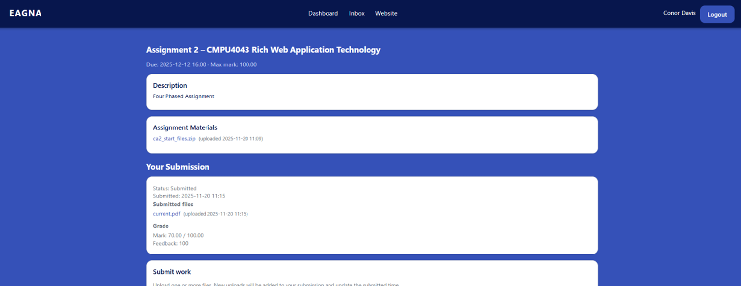
The Prototype
Numerous different testing and evaluation methods will be used.
Testing:
Black / White Box Testing
Unit Testing
Evaluation:
Nielsen's Heuristics
User Feedback
TPC / CIS Benchmarks
Four Golden Signals
THE PROTOTYPE

Slide 12
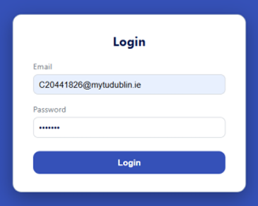
Interim Features Student & Lecturer
Login System (& Logout)
Module Functionality
Assignment Functionality
Navigation Menus & Links
Numerous different testing and evaluation methods will be used.
Testing:
Black / White Box Testing
Unit Testing
Evaluation:
Nielsen's Heuristics
User Feedback
TPC / CIS Benchmarks
Four Golden Signals
TIME FOR THE DEMO

Slide 13
THANK YOU.
Any Questions?

